Slide 1
Self normalizing neural networks and orthogonal initialization
Krzysztof Kolasiński, 27.06.2017

Slide 2
Content
SELU activation function
LSUV
My benchmarks on CIFAR10
Another benchmarks

Slide 3
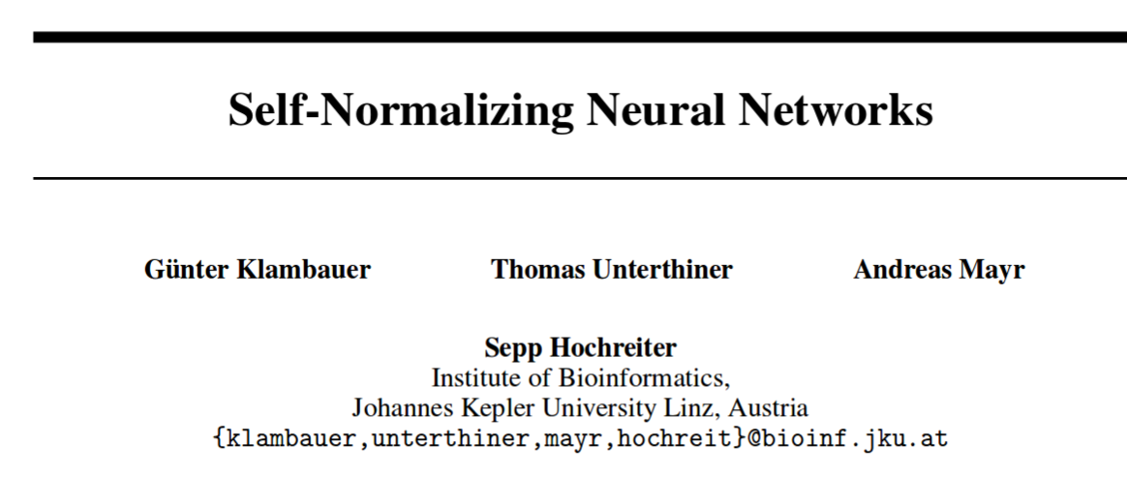
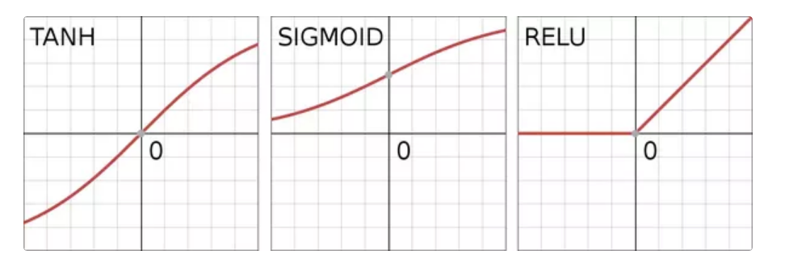
Self Normalizing Neural Networks (22 June 2017)
The motivation for unit variance activations in NNs
source: qoura

Slide 4
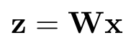
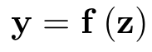
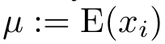
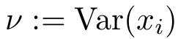
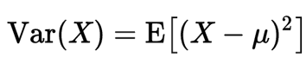
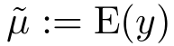
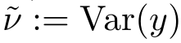
Self Normalizing Neural Networks
We consider dense layer with activation f and weight matrix W
The activations in higher layer are
if x are a random variables then z as well.
The authors assume that all activations x have same mean and variance
Same for activations in higher layer

Slide 5
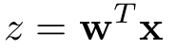
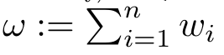
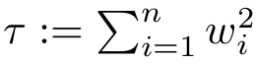
Self Normalizing Neural Networks
We consider dense layer with activation f and weight matrix W
The activations in higher layer are
if x are a random variables then z as well.
The authors assume that all activations x have same mean and variance
Same for activations in higher layer
Single activation is defined with weight vector:
They define new variables:

Slide 6
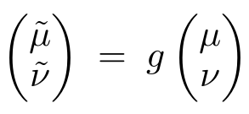
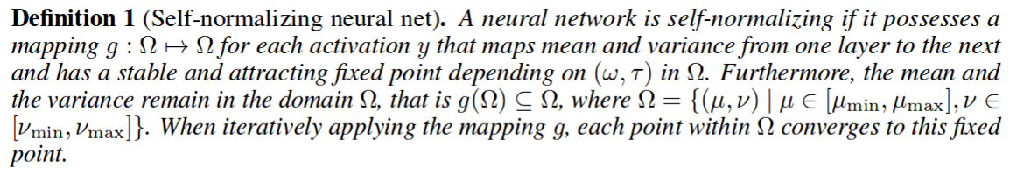
Self Normalizing Neural Networks
We consider dense layer with activation f and weight matrix W
We define general mapping which one layer performs

Slide 7
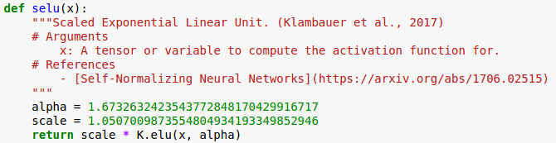
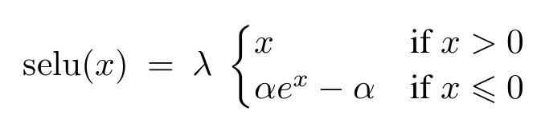
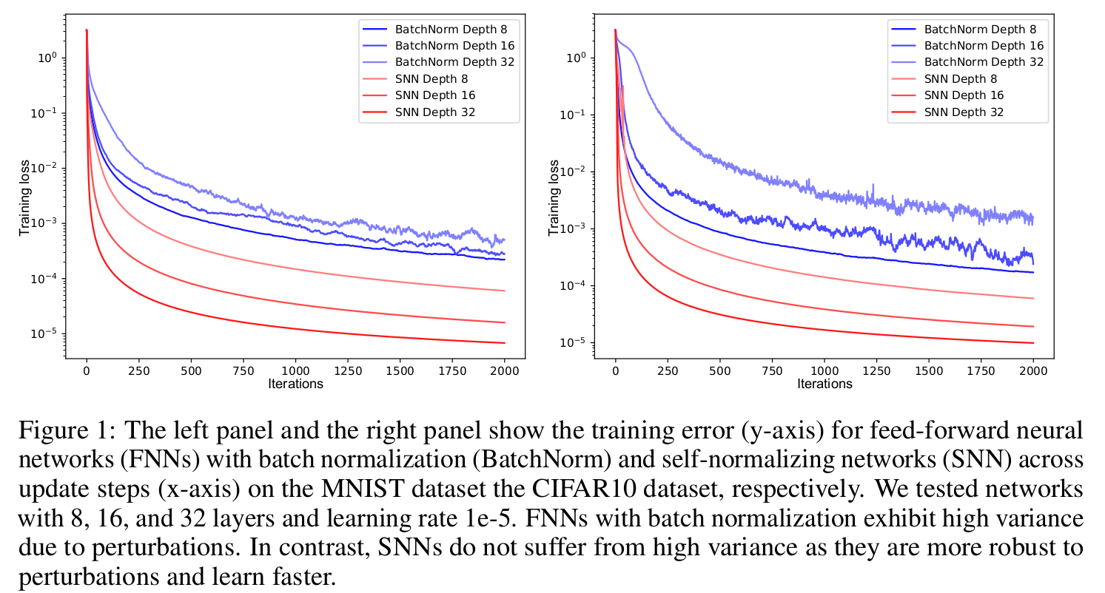
Self Normalizing Neural Networks
How does it work?

Slide 8
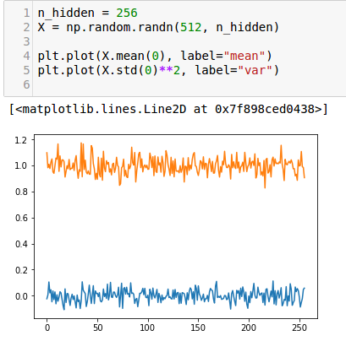
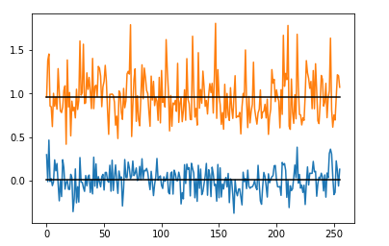
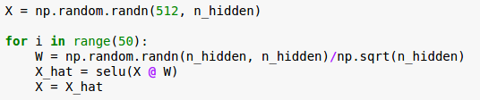
Self Normalizing Neural Networks
How does it work?
The idea behind self normalization:
Propagate through the network 50 layers

Slide 9
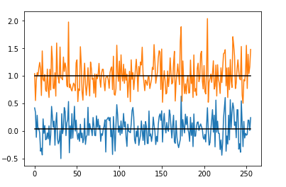
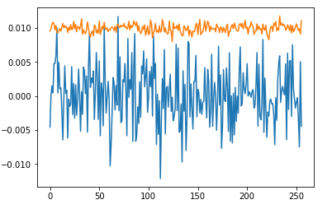
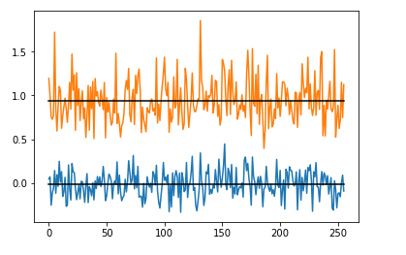
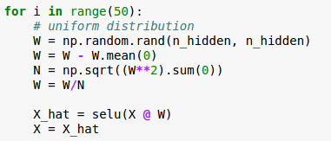
Self Normalizing Neural Networks
How does it work?
The idea behind self normalization:
Propagate through the network 50 layers
The network self normalized outputs
Same but W is initialized from uniform distribution (still stable)
Show this demo

Slide 10
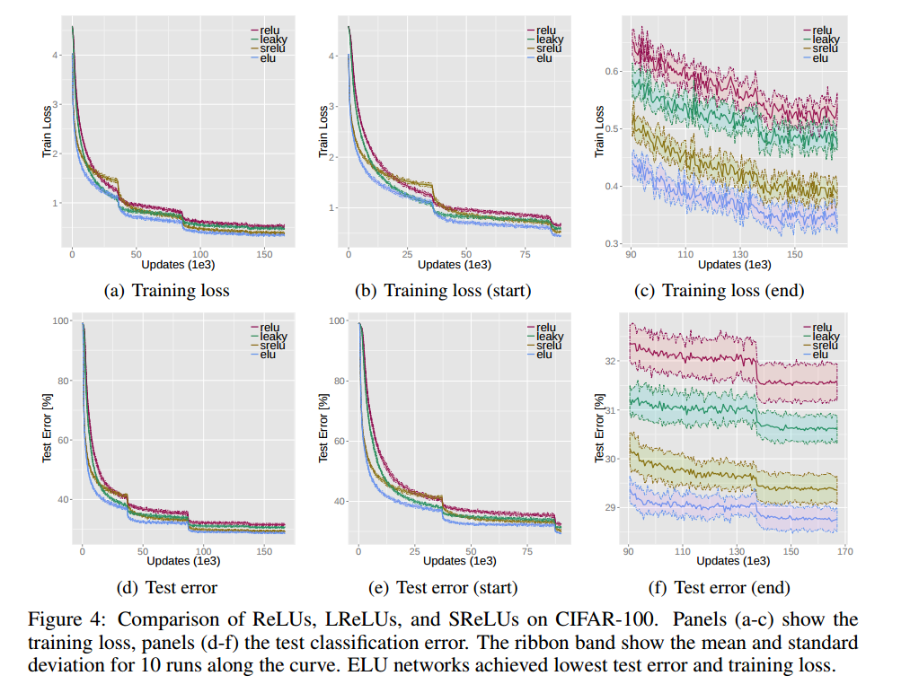
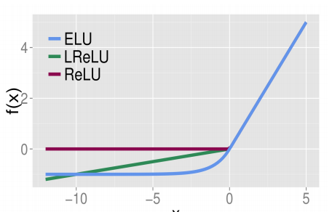
Self Normalizing Neural Networks
Constructing SNNs: the authors propose following parametrization for g
scaled exponential linear unit
no prelu in their benchmark...
arxiv: 1511.07289

Slide 11
Self Normalizing Neural Networks
Constructing SNNs: the authors propose following parametrization for g
Some clues for constructing SNNs (according to authors)
Won’t work with Relu, sigmoid
must have negative and positive values for controlling mean
saturation regions to dampen the gradients when activation is too large in lower layer
a slope larger than 1 to increase the variance when to small in lower layer
a continuous slope to provide fixed point
They impose initialization condition on the weight vectors:

Slide 12
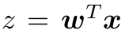
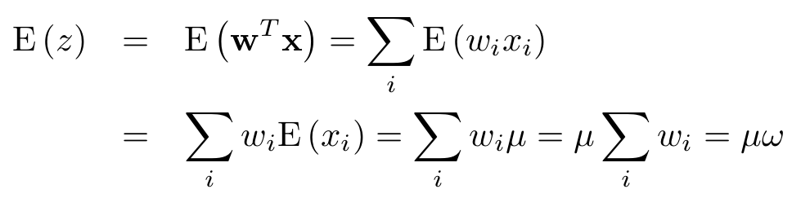
Derivation of mapping function
Constructing SNNs: the authors propose following parametrization for g
Assumptions:
activations x_{i} are independent (not full filled in general)
and share the same mean and variance
The mean activation of
from the assumption

Slide 13
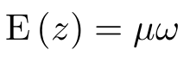
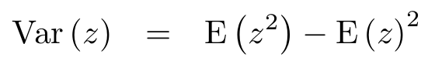
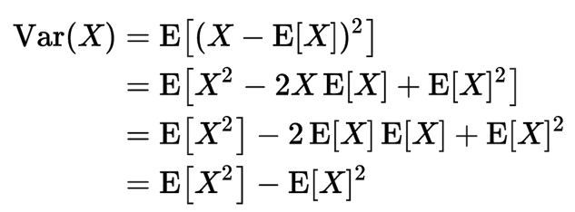
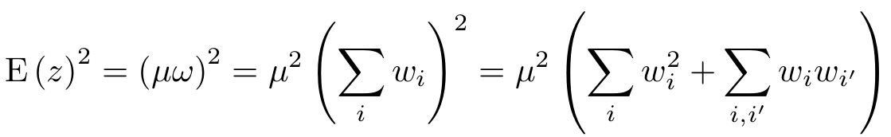
Derivation of mapping function
Constructing SNNs: the authors propose following parametrization for g
The mean of activations of z is
The variance of activations:
Computing second term

Slide 14
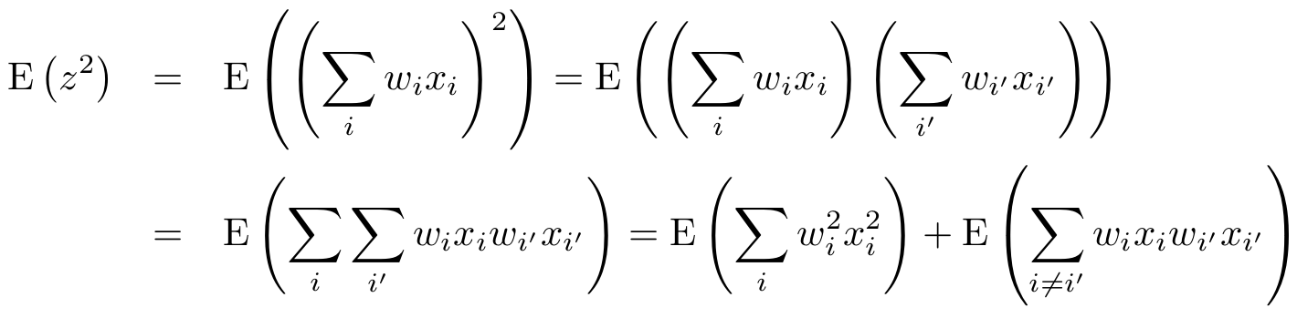
Derivation of mapping function
Constructing SNNs: the authors propose following parametrization for g
The variance of activations:
Second term
First term:

Slide 15
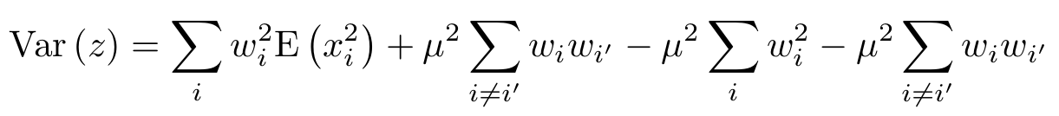
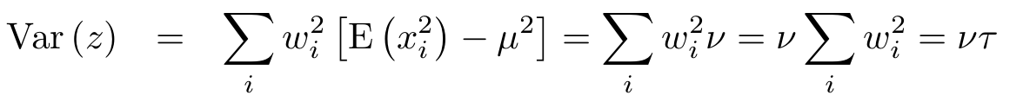
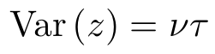
Derivation of mapping function
Constructing SNNs: the authors propose following parametrization for g
The variance of activations:
The final expression is:
Mean:
Variance:

Slide 16
Derivation of mapping function
Constructing SNNs: the authors propose following parametrization for g
The mean and variance:
According to CTL the z variable approaches to normal distribution (z is a weighted sum of independent variables)
larger z then more correct is this statement

Slide 17
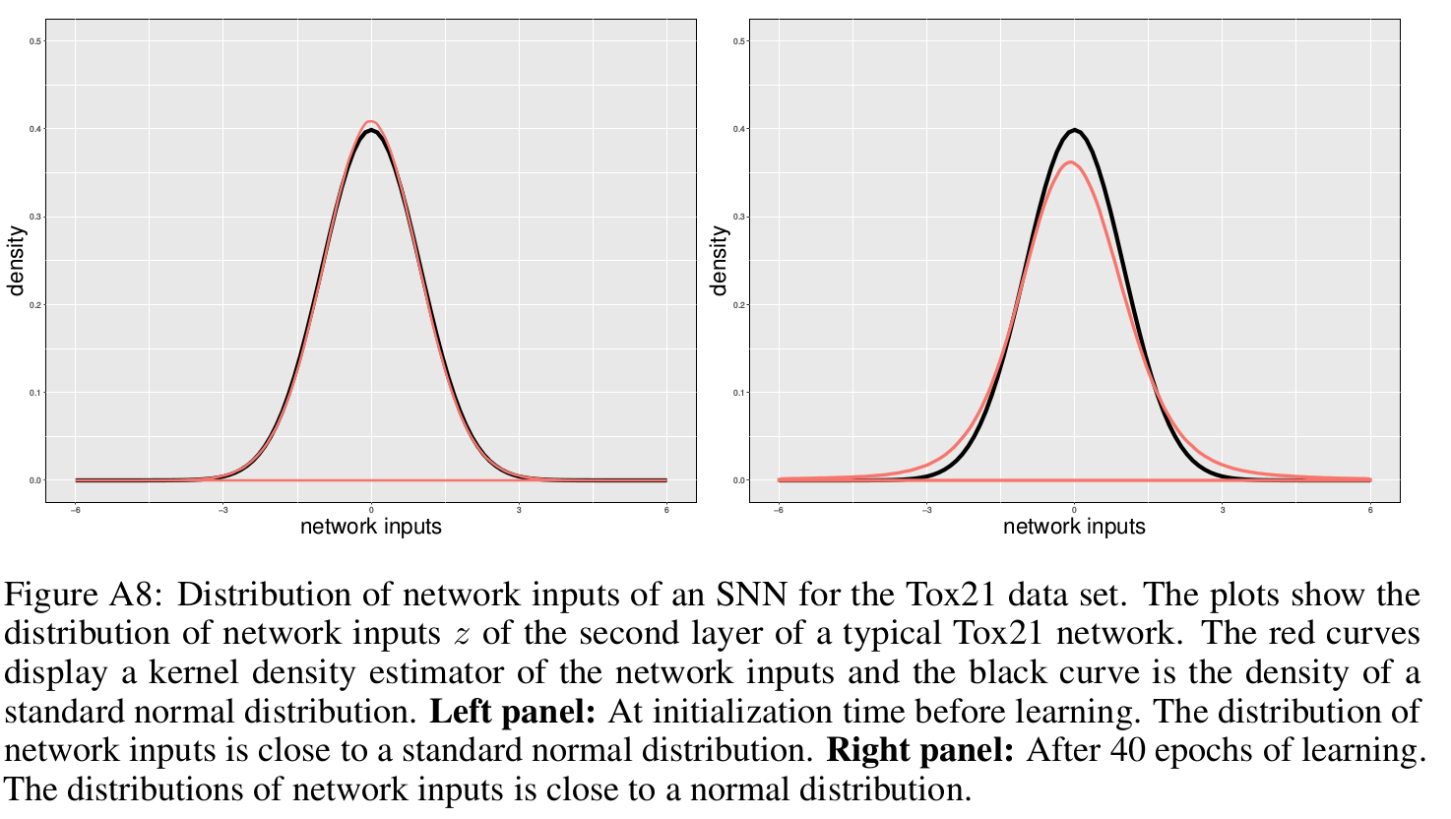
Derivation of mapping function
Constructing SNNs: the authors propose following parametrization for g
z is a roughly random variable from normal distribution

Slide 18
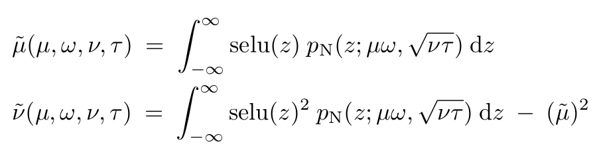
Derivation of mapping function
Constructing SNNs: the authors propose following parametrization for g
z is a roughly random variable from normal distribution
The mean and variance after applying selu is then:
Can be integrated analytically

Slide 19
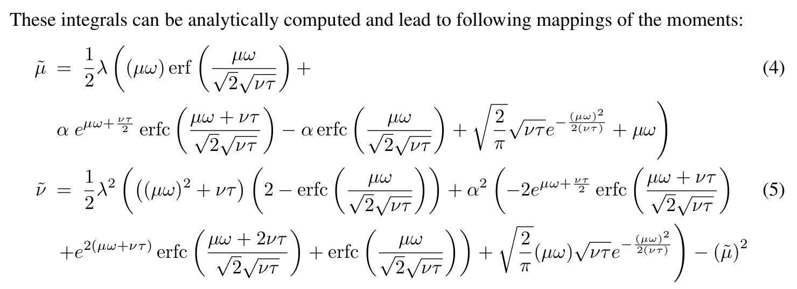
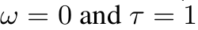
Derivation of mapping function
Constructing SNNs: the authors propose following parametrization for g
assume normalized weight vector
given a fixed point (μ, ν) = (0, 1) one may solve this equation for selu parameters:

Slide 20
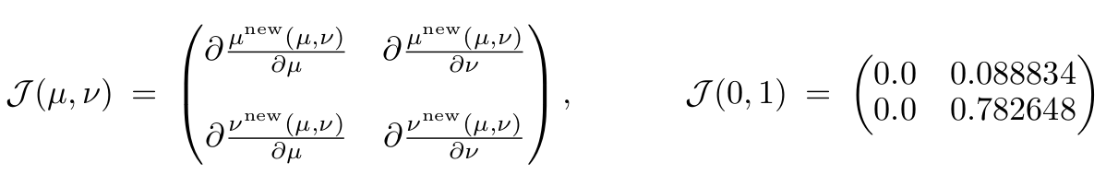
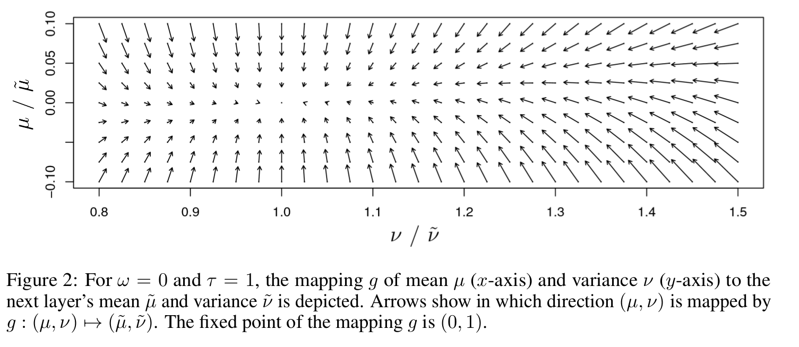
Derivation of mapping function
Constructing SNNs: the authors propose following parametrization for g
Is fixed point (μ, ν) = (0, 1) stable and attractive?
From stability theory:
stable is if: the spectral norm of transformation Jacobian is less than one.

Slide 21
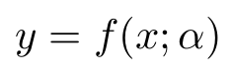
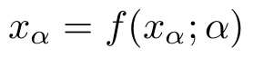
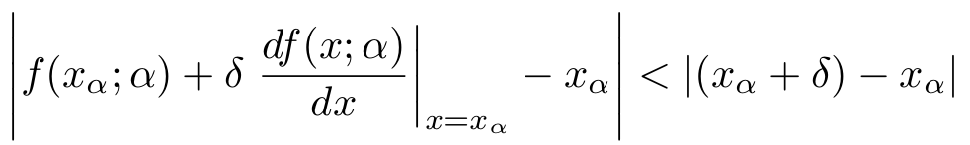
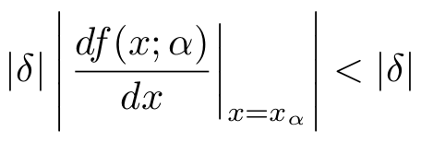
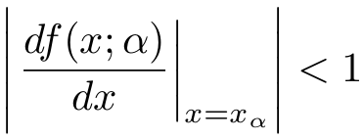
Derivation of mapping function
A 1D example for stability theory
Consider general mapping x -> y
In previous example we have fixed (x) and (y) and computed alpha which gives
Stability is when following condition is satisfied

Slide 22
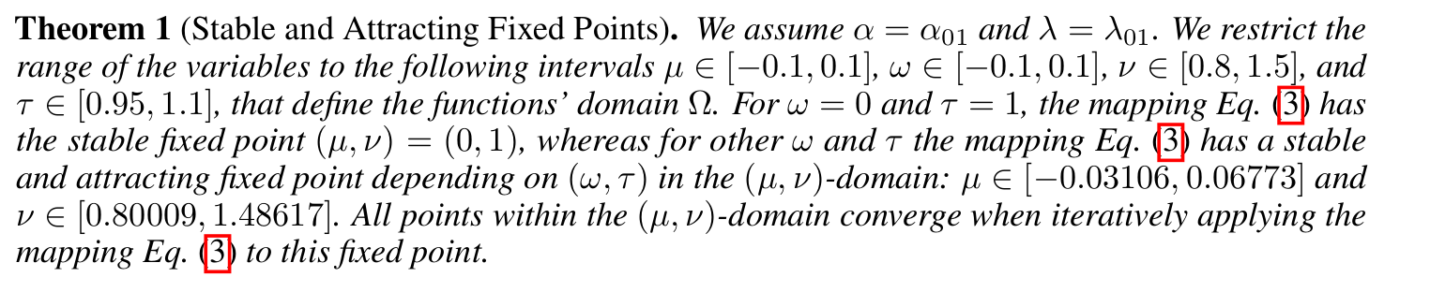
Derivation of mapping function
Constructing SNNs: the authors propose following parametrization for g
What if weights are not normalized:
computer assisted proof

Slide 23
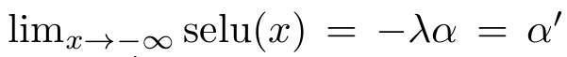
New dropout technique
Standard dropout fits well with Relus since 0 is a default (minimum) value for it. Dropout preserves the mean of activations
Alpha dropout sets minimum SELU value instead of zero
Basic idea is: apply alpha dropout to activations, then apply affine transform of form a*x + b which preserves the mean E(x) and variance Var(x) of activations

Slide 24
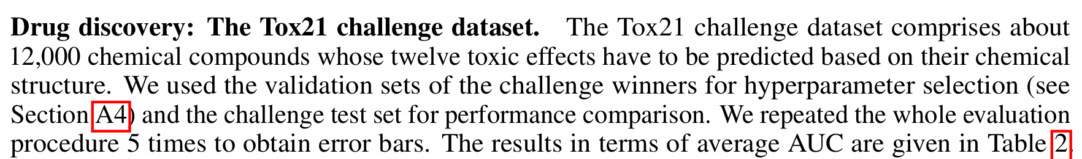

Some experiments (LB from 2014 is ~82)

Slide 25


Some experiments

Slide 26

Conclusions from paper
Deep learning with SELUs

Slide 27
Conclusions from paper
Usage of CLT as a general tool for understanding NN
Activations may drive outputs of neural network to certain distributions
What if we can create activation function, which will be able to keep weights of neural network at specific distribution ?

Slide 28


LSUV initialization
The authors propose a Layer-Sequential-Unit Variance initialization.
The algorithm is very simple:
Initialize the matrices to be orthonormal
Go layer-by-layer and scale their weights such that they will produce unit variance activations
The algorithm:

Slide 29

LSUV initialization - some benchmarks from paper
In most cases it seems that it provides better start

Slide 30


LSUV initialization - some benchmarks from paper
In most cases it seems that it provides better start
strange behaviour in accuracy???

Slide 31






LSUV initialization - continuation ….
https://arxiv.org/pdf/1703.01827.pdf (6 Mar 2017)
https://arxiv.org/abs/1609.07093 (22 Sep 2016)
https://arxiv.org/pdf/1702.00071.pdf (31 Jan 2017)

Slide 32


My experiments - FCN 4 layers ~ 1M params
Architecture:
?
?
4 FC layers, with hidden vectors 256
Activations: SELU, RELU, PRELU, ELU, LINEAR
Normalization: Batch, SELU
Activity regularization: Batch
Initialization: LSUV, GLOROT, SELU
?

Slide 33


My experiments

Slide 34

My experiments - ranking

Slide 35


My experiments - Vgg like CNN
Architecture:
? :D

Slide 36

My experiments - Vgg like CNN about 2M params
selu
selu
elu

Slide 37


My experiments - Vgg like CNN about 2M params

Slide 38

My experiments - Vgg like CNN about 2M params
Histograms of activations???

Slide 39


Another benchmarks
Super cool benchmark github project!!!
https://github.com/ducha-aiki/caffenet-benchmark
https://arxiv.org/abs/1606.02228

Slide 40
Questions?

Slide 41
References
https://en.wikipedia.org/wiki/Activation_function - nice list of differenct activation functions
https://arxiv.org/pdf/1511.07289.pdf - elu paper
https://calculatedcontent.com/2017/06/16/normalization-in-deep-learning/ - quite well written blog about normalization in NNs
https://github.com/NVIDIA/DIGITS/blob/master/examples/weight-init/README.md - comparison of different initialization schemes and their effect on learning process
https://www.reddit.com/r/MachineLearning/comments/6n9bkm/p_understanding_visualizing_selfnormalizing/ - discussion about SELU on reddit
https://gist.github.com/eamartin/d7f1f71e5ce54112fe05e2f2f17ebedf - some insights on how SELUs works. Actually very nice jupyter notebook.
https://www.reddit.com/r/MachineLearning/comments/6g5tg1/r_selfnormalizing_neural_networks_improved_elu/dise43y/ - reddit discussion

Slide 42
References
https://arxiv.org/pdf/1511.06422.pdf - All you need is a good init
https://arxiv.org/pdf/1703.01827.pdf - All You Need is Beyond a Good Init
https://github.com/ducha-aiki/caffenet-benchmark - cool benchmark on different configurations of regularization and activations functions
https://arxiv.org/abs/1606.02228 - Systematic evaluation of CNN advances on the ImageNet
https://arxiv.org/abs/1706.02515 - Self-Normalizing Neural Networks

Slide 43


